Slide 1
Unit 1: Machine Learning

Slide 2
What is Machine Learning?
It is a field of computer science where a computer program learns from data and improves its performance without being explicitly programmed.
It involves feeding data into algorithms to identify patterns and make predictions on new data.
Everyday Examples of ML
  Spam Filter: Learns from past labeled emails to detect spam.
  Netflix Recommendations: Learns from your past viewing history to suggest movies.
  Self-driving Cars: Learn from millions of driving scenarios.
Notes:
Instead of writing step-by-step instructions, we give the computer examples (data), and it learns patterns to make predictions or decisions.
Applications example:
Image recognition: a face image is not just a random collection of pixels; a face has structure. It is symmetric. There are the eyes, the nose, the mouth, located in certain places on the face. Each person’s face is a pattern composed of a particular combination of these. By analyzing sample face images of a person, a learning program captures the pattern specific to that person and then recognizes by checking for this pattern in a given image. This is one example of pattern recognition.

Slide 3
Definition of Machine Learning
Tom Mitchell’s definition (1997):
A computer program is said to learn from experience E with respect to some class of tasks T and performance measure P if its performance at tasks in T, as measured by P, improves with experience E.”
“Key elements of a learning problem:
Task (T): What the system is trying to do (e.g., classify emails as spam/not spam).
Experience (E): Data the system learns from (e.g., past labeled emails).
Performance (P): How well the system performs, often measured by accuracy, error rate, or reward.

Slide 4
Example
Supermarket chain
Scenario
  A supermarket chain has millions of customers and thousands of products.
  Sales happen through physical stores and online stores.
Data Collected
Each transaction records:
    Date & time of purchase
    Customer ID
    Items purchased and quantity
    Total money spent

Slide 5
Example
Challenge (Why ML is needed?)
  Huge amount of data is generated every day.
  Hard for humans to analyze and predict customer behavior manually.
Business Goal
  Predict which customer is likely to buy which product(discover associations)
  Use this to:
    Personalize product recommendations
    Maximize sales and profit
    Improve customer satisfaction
Customer’s Goal
  Customers want to quickly find products that best match their needs (like ice cream in summer, spices in winter).
  Avoid searching through irrelevant items.
Notes:
Basket Analysis problem
Looks for products that are frequently bought together.
Example: Beer 🍺 and Chips 🍟.

Slide 6
Example
Why Not Random?
  Customers don’t buy items randomly.
  Their choices follow patterns:
    Beer → Chips
    Ice cream → Summer
    Glühwein (mulled wine) spices → Winter
  These patterns can be learned by ML.
ML Task
  Identify these patterns in historical data.
  Use them to recommend products → e.g., “People who bought X also bought Y”.
ML Techniques Used
  Association Rule Mining (e.g., Apriori algorithm) → discovers item-to-item rules.
  Recommendation Systems → personalizes products for each customer.
Notes:
Customer behavior changes in time and by geographic location. But we know that it is not completely random.
People do not go to supermarkets and buy things at random. When they buy beer, they buy chips; they buy ice cream in summer and2 1 Introduction spices for Glühwein in winter. There are certain patterns in the data.
If customers who buy X often also buy Y, then a customer who buys X is a potential Y buyer.
Store can recommend or promote Y → cross-selling.
Association Rule
Expressed as:
$$X ⟹ Y$$
(If X is bought, Y is also likely to be bought).

Slide 7
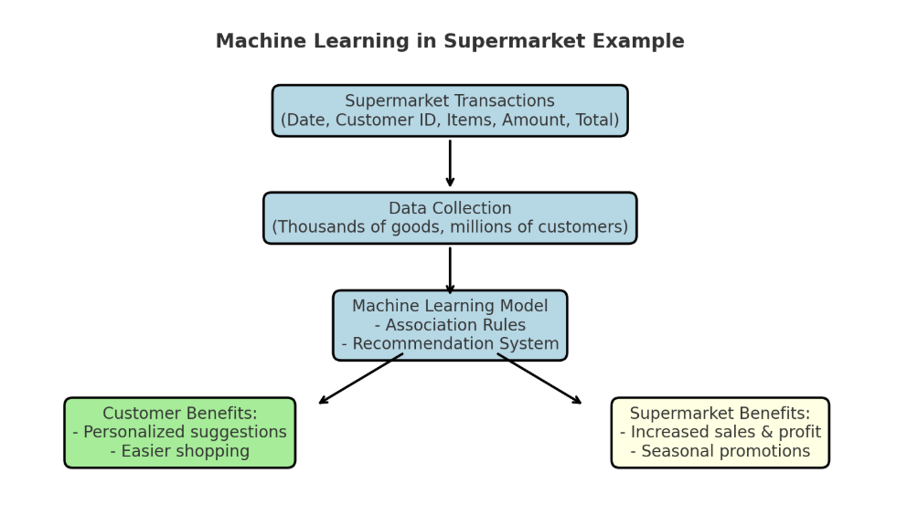
Example
Outcome
  Customers see relevant product suggestions.
  Supermarket increases cross-selling (beer + chips) and seasonal sales (ice cream in summer).
  Both profit and customer satisfaction improve.
Notes:
How it is Used
Identify cross-selling opportunities (recommend chips when someone buys beer).
Design promotions (bundle products together).
Improve store layout (place associated items close together).

Slide 8
Traditional Programming vs ML
requires exact instructions
doesn’t handle complex tasks like understanding images or language well
It can’t efficiently process large amounts of data.
Machine Learning solves these problems by learning from examples
making predictions without fixed rules

Slide 9
Why do we need Machine Learning?
Solving Complex Business Problems
Handling Large Volumes of Data
Automate Repetitive Tasks
Personalized User Experience
Notes:
Solving Complex Business Problems : egImage and speech recognition in healthcare.
Language translation and sentiment analysis.
Handling Large Volumes of Data
he internet generates huge amounts of data every day. Machine Learning processes and analyzes this data quickly by providing valuable insights and real-time predictions.
Examples:
Fraud detection in financial transactions.
Personalized feed recommendations on Facebook and Instagram from billions of interactions.
Automate Repetitive Tasks
ML automates time-consuming, repetitive tasks with high accuracy hence reducing manual work and errors.
Examples:
Gmail filtering spam emails automatically.
Chatbots handling order tracking and password resets.
Automating large-scale invoice analysis for key insights.
Personalized User Experience
ML enhances user experience by tailoring recommendations to individual preferences. It analyze user behavior to deliver highly relevant content.
Examples:
Netflix suggesting movies and TV shows based on our viewing history.
E-commerce sites recommending products we're likely to buy.

Slide 10
Image recognition
Recognition happens even when:
  Pose is different
  Lighting changes
  Hair style changes
A face is not just random pixels; it has a structure:
  Symmetry
  Eyes, nose, mouth appear in fixed relative positions.
Each person’s face is a unique combination of these features.
  Example: Distance between eyes, shape of nose, curve of lips.
Machine Learning Approach
  Collect sample face images of a person.
  The ML model learns the pattern specific to that person.
Application
  Phone unlocking (Face ID)
  Security systems (CCTV)
  Social media photo tagging
Notes:
Human Ability
We see family and friends’ faces daily.
Recognition happens even when:
Pose is different
Lighting changes
Hair style changes
But we do this unconsciously (we can’t explain how exactly).
Challenge for Computers
Since humans can’t explain the exact step-by-step process, it’s hard to write an explicit program for face recognition.
Key Idea
A face is not just random pixels; it has a structure:
Symmetry
Eyes, nose, mouth appear in fixed relative positions.
Individual Patterns
Each person’s face is a unique combination of these features.
Example: Distance between eyes, shape of nose, curve of lips.
Machine Learning Approach
Collect sample face images of a person.
The ML model learns the pattern specific to that person.
Later, given a new image, the model checks:
Does this image match the learned pattern?
Application
This is an example of Pattern Recognition (finding and identifying patterns in data).
Used in:
Phone unlocking (Face ID)
Security systems (CCTV)
Social media photo tagging

Slide 11
Speech Recognition
Speech recognition means converting spoken language into text using machine learning.
  Example: When you say “Call Mom”, your phone converts the audio into words and executes the command
Speech varies a lot due to:
  Accent (British vs. Indian English)
  Speed (fast vs. slow talkers)
  Background noise
  Pronunciation differences
Human speech is not random noise.
It has patterns:
  Words are made of phonemes (basic sound units).
  Certain combinations occur frequently (like “th” in English).
ML approach
  Collect training data: Recordings of many people speaking words/sentences with their transcriptions.
  Feature extraction: Convert raw audio waves into features like frequency patterns (MFCCs).
  Model training: Train ML models (HMM, Deep Learning, RNNs, Transformers) to learn the mapping from sound → words.
  Prediction: When new audio is given, the model predicts the most likely sequence of words.
Application
  Alexa, Siri, google Assistant
Notes:
Writing a manual program to handle all these variations is impossible.
Example : alexa
User says: “Play music.”
System converts audio → text → command.
The model recognizes the pattern of sounds matching the words “play” and “music.”
The assistant starts the music app.

Slide 12
Basic Concepts of ML
Concepts:
  Model: A representation of learned knowledge.
  Training: Process of fitting the model to data.
  Testing: Evaluating the model on unseen data.
  Features: Input variables used for learning.
  Labels/Targets: Output we want to predict.

Slide 13
Topics
Supervised Learning (Applications)
Classification(Algorithms)
Regression(Algorithms)
Unsupervised Learning(Applications and Algorithms)
Reinforcement learning(Applications and Algorithms)
Induction learning
Deductive Learning
Important terms- knowledge extraction, compression, outlier detection, density estimation, clustering

Slide 14
Supervised Learning
A type of Machine Learning where the algorithm learns from labelled data.
Labelled data = input (features) + output (target).
Goal: Learn a mapping from input → output.
It involves training a model on a dataset that contains input features and corresponding output labels, allowing the model to learn the relationship between the inputs and outputs.
The model learns from this labelled data to make predictions or classify new, unseen data accurately
Notes:
Goal: Learn the mapping from inputs → output, so that it can predict outputs for new inputs.
Think of it as a teacher guiding a student through a textbook. The teacher knows the correct answers (the target labels), and the student(model) learns by comparing their answers (predictions) to the teacher's.

Slide 15
Input Features & Target Variables
Input Features: These are the variables or attributes that describe the data. These are the independent variables or predictors.
Can be numbers (age, marks, salary) or categories (gender, city, product type).
Example: In a spam email detection system, the input features might include the sender's email address, subject line, and the content of the email. The algorithm uses these features to make predictions.
Target Labels: These are the values we want the algorithm to predict or classify. These labels are provided as part of the training data. This is the dependent variable or output.
It is what you want the model to predict. Usually just one column in your dataset.
Example: In the case of spam email detection, the target labels would be binary: “spam” (1) or “not spam” (0).
Notes:
Example :you want to predict house price, the input features could be:
Size of the house (sq.ft)
Number of rooms
Location
Age of the house

Slide 16
Input Features & Target Variables
During training → model learns the relationship between features (X) and target (y).
During prediction → you give only the features (X), and the model predicts the target (y).

Slide 17
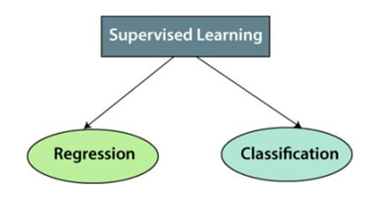
Types of Supervised Learning
No labels
Predicting values
Defined labels
Predicting category/class

Slide 18
Regression
It is a type of supervised learning where the goal is to predict continuous values or numerical quantities.
In regression tasks, the target labels are real numbers, and the model learns to map input features to a continuous output.
Example problems:
  Predicting house prices 🏠
  Predicting temperature 🌡️
  Predicting salary
  Predicting stock prices
Algorithms : Linear Regression, Polynomial Regression, Ridge/Lasso Regression, etc.

Slide 19
Classification
A type of supervised learning where the goal is to assign data points to predefined categories or classes.
In classification tasks, the target labels are discrete and represent different classes or groups(like “yes/no” or “A/B/C”).
Types of classification
  Binary classification- 2 classes – spam/not spam, fraud/not fraud
  Multiclass-classification- more than 2 classes- classifying emails as spam, promotional, social, and primary.
Examples:
  Determining if a customer review is "positive" or "negative”
  Predicting if a patient has a disease
  image recognition (identifying if an image contains a cat or a dog)
Algorithms: Logistic regression, support vector machines, decision trees, random forests, and neural networks
Notes:
Determining if a customer review is "positive" or "negative”- Sentiment Analysis

Slide 20
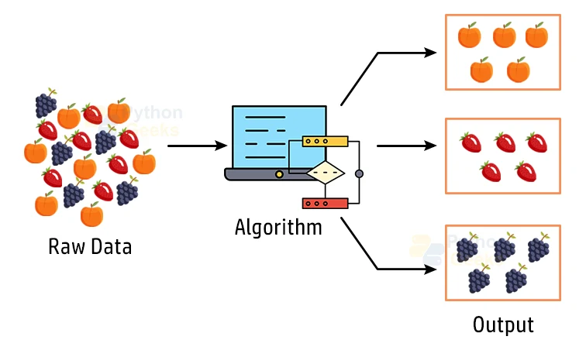
Unsupervised Learning
It is a type of ML in which an algorithm is trained on a dataset without the use of labeled examples(no supervisor).
It is a type of learning that is based on the idea of discovering patterns in data, and is often used to extract features or to cluster data into groups.
We don’t tell the model what to predict; it discovers patterns on its own.
Example: Imagine you give a basket of mixed fruits 🍎🍌🍇🥭 to a machine, but you don’t tell it the fruit names.
The machine groups similar fruits together (all apples in one group, all bananas in another, etc.).
That’s unsupervised learning → discovering natural groupings.
Notes:
In unsupervised learning, the dataset has only input features (X), but no target/output (y).
Goal: find regularities, patterns, or structure in the data
3) Only input data is given.
Density estimation:
If you plot data, some regions will have many points (high density), and others will have fewer (low density).
Density estimation helps us model this distribution mathematically.

Slide 21
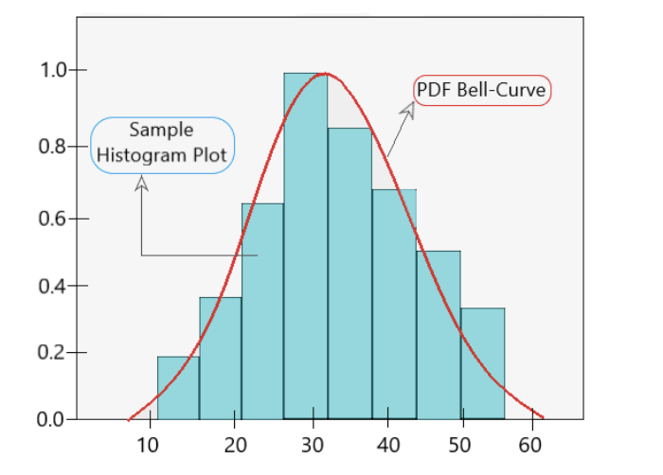
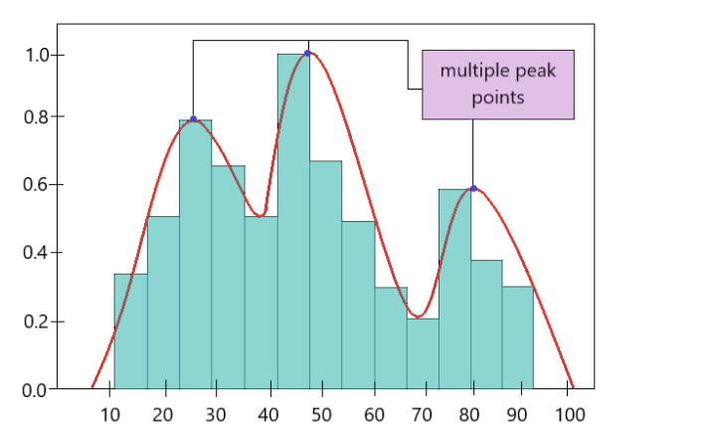
Unsupervised Learning
Density Estimation: the task of estimating the probability distribution that generated a dataset.
Given data points, we want to figure out how the data is distributed (where data points are concentrated vs. sparse).
Two approaches: Parametric & Non-parametric
Notes:
Why is it useful?
Anomaly Detection: Detect unusual events (fraud in banking, defective products).
Clustering: Helps group data points by density.
Data Generation: Used in generative models (GANs, VAEs).
Visualization: To understand how data is spread.
Example: Imagine exam marks of 100 students:
Most students scored between 60–80 → high-density region.
Few scored below 30 or above 90 → low-density region (outliers).
A density estimation curve will show this distribution instead of just listing marks.
Parametric Density Estimation is a statistical technique used to estimate the probability distribution of a dataset by assuming that the data follows a specific distribution with a set of parameters.

Slide 22
Clustering
Clustering is the task of grouping data points such that:
  Points in the same group (cluster) are more similar to each other.
  Points in different groups are less similar.
Customer Segmentation
  Group customers with similar demographics/transactions.
  Helps in targeted strategies (services/products).
Algorithms like K-Means Clustering group customers with similar behavior.
Features used can include:
  Age, Gender, Location
  Buying frequency
  Amount spent
  Types of products purchased
Notes:
From book:
Customer segmentation is the process of dividing customers into different groups (segments) based on similar characteristics.
Goal: Understand customers better and design targeted marketing strategies.
Why do we need it?
Not all customers are the same.
Some buy frequently, some rarely.
Some prefer discounts, others prefer premium products.
By segmenting customers, businesses can:
Improve marketing campaigns
Personalize offers
Increase sales and customer satisfaction

Slide 23
Image Compression
Images often contain millions of pixels with slightly different colors.
Input: pixels as RGB values.
Compression = reducing the amount of data needed to store the image, while keeping it visually similar.
Similar pixels grouped → represented by an average color.
Example:
Original image: 1,000,000 pixels, ~16 million possible colors.
After clustering with k = 16:
  Only 16 representative colors are stored.
  Image looks almost the same, but file size is much smaller.
Notes:
Cluster colors into a small number of groups.
Replace each pixel’s color with the nearest cluster center (representative color).
Used in JPEG compression, web images, and mobile apps.

Slide 24
Document Clustering
Document clustering is the task of grouping documents (text data) into clusters such that:
  Documents in the same cluster are similar in content.
  Documents in different clusters are dissimilar.
Each document (e.g., news article, research paper, blog) is treated as a collection of words(bag of words).
Using text processing techniques, we convert documents into numerical feature vectors.
Clustering algorithms (like K-Means) group documents based on word similarity.
Example: Used for classifying news (politics, sports, fashion, etc.).
Notes:
Bag of Words (BoW), Stemming, and Lemmatization
1. Bag of Words (BoW)
A simple way to represent text as numerical features.
Treats each document as a bag (set) of words, ignoring order and grammar.
Focuses only on word frequency.
Example
Two sentences:
“I love machine learning.”
“Machine learning is fun.”
Vocabulary = {I, love, machine, learning, is, fun}
Document 1 → [1,1,1,1,0,0]
Document 2 → [0,0,1,1,1,1]
👉 Each document is turned into a vector.
Pros: Simple, effective.
Cons: Ignores word order and meaning.
2. Stemming
Process of reducing words to their root form by chopping off endings.
Example:
“playing” → “play”
“played” → “play”
“player” → “play”
⚠️ It’s a rule-based crude method (sometimes gives non-dictionary roots).
Example: “studies” → “studi”
3. Lemmatization
More advanced than stemming.
Reduces words to their base/dictionary form (lemma) using vocabulary and grammar rules.
Example:
“playing” → “play”
“better” → “good”
“studies” → “study”
👉 Always produces valid words (unlike stemming).
4. Why are they important?
Text data has many forms of the same word.
Stemming/Lemmatization normalize words so that BoW or TF-IDF models don’t treat them as separate.
Example:
Without stemming → “play”, “playing”, “played” are 3 different features.
With stemming/lemmatization → all reduced to “play”.
✅ Quick Summary for Students
BoW: Text → Word frequency vector (ignores order/grammar).
Stemming: Cut words to root (fast but crude).
Lemmatization: Smarter, reduces to dictionary form (slow but accurate).

Slide 25
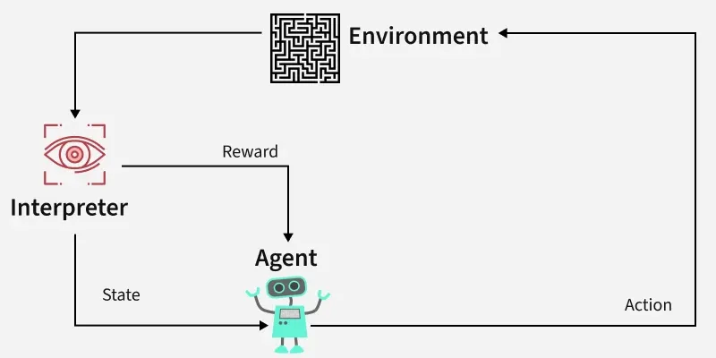
Reinforcement Learning
It is a type of Machine Learning where an agent learns by interacting with an environment to make decisions through trial and error to maximize cumulative rewards.
The agent takes actions → receives rewards or penalties → learns the best strategy (policy) to maximize long-term reward.

Slide 26
Reinforcement Learning
Key Concepts
Agent → Learner/decision maker that performs action (robot, game player).
Environment → The world the agent interacts with (game board, traffic system).
Action → What the agent does/possible moves/ decision the agent makes
State → Current situation/condition of the environment.
Reward → Feedback (positive or negative) after an action.
Policy → Strategy agent follows to decide next action based on current state.
Notes:
Imagine training a dog 🐶:
Say “sit”, if dog sits → give a biscuit (reward).
If it doesn’t → no reward.
Over time, the dog learns the best action (sit when asked).
👉 This is exactly how RL works!

Slide 27
Applications
Game Playing
  Example: Chess.
  A single move is not important; the sequence of right moves (policy) is.
  Easy to describe (simple rules).
  Hard to play well (huge number of possible moves and strategies).
Robot Navigation
  Robot learns the sequence of moves to reach a goal location.
  Must avoid obstacles and minimize time.
  Learning comes from repeated trial runs.
Self-Driving Cars
  Car (agent) decides speed/steering.
  Reward = safe driving, reaching the destination faster.
  Penalty = accidents, traffic violations.
Notes:
RL = Learning by trial and error with rewards & penalties.
Agent + Environment + Rewards + Actions + Policy.

Slide 28
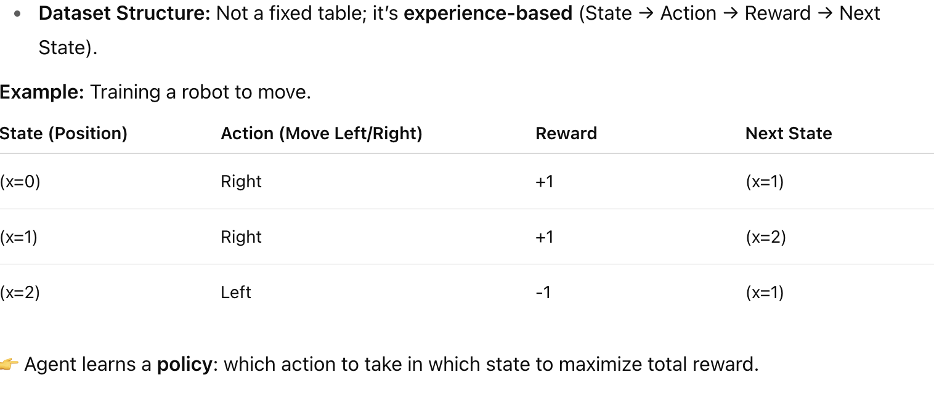
Dataset for Reinforcement

Slide 29
Advantages
Solves complex problems: RL can handle tasks too complex to program with fixed rules (e.g., self-driving cars, robotics).
Adaptability: Can adapt to dynamic environments (e.g., traffic changes, stock markets), where outcomes are uncertain or change over time, making it highly useful for real-world applications.
Error Correction: The model continuously learns from its environment and can correct errors that occur during the training process.
No Need for Labeled Data: Unlike supervised learning, RL doesn’t need labeled input-output pairs. It learns from experience (rewards/penalties)
Long-Term Optimization: Focuses on maximizing future cumulative reward, not just immediate outcomes.

Slide 30
Disadvantages
High Computational Cost: Needs a lot of computing power (training AlphaGo took thousands of CPUs/GPUs)
Time-Consuming: Learning by trial and error may take millions of interactions to converge.
Dependency on Reward : If rewards are poorly designed, the agent may learn the wrong behavior (reward hacking).
Not Always Stable: Training may be unstable and not guarantee optimal solutions.

Slide 31
Key Concepts to be revised at the end
Key Concepts
Data
  ML needs data (examples, past records).
  Types: structured (tables), unstructured (images, text, audio).
Features and Labels
  Features (X): Input variables (e.g., hours studied, size of house).
  Label/Target (y): Output variable we want to predict (e.g., exam marks, house price).
Training vs. Testing
  Training Data: Used to teach the model patterns.
  Testing Data: Used to evaluate how well the model generalizes to unseen data.
Model
  Mathematical representation of the relationship between inputs and outputs.
  Example: Linear Regression → y = mx + c.
Learning Types
  Supervised Learning: Learn from labeled data (e.g., predict house price).
  Unsupervised Learning: Find hidden patterns in unlabeled data (e.g., customer segmentation).
  Reinforcement Learning: Learn by trial-and-error with rewards (e.g., training a robot).
Overfitting vs. Underfitting
  Overfitting: Model learns training data too well, fails on new data.
  Underfitting: Model too simple, fails to capture patterns.
  Goal = Good Generalization.
Evaluation Metrics
  For regression: Mean Squared Error (MSE), R².
  For classification: Accuracy, Precision, Recall, F1-score.
Algorithms
  Linear Regression, Logistic Regression
  Decision Trees, Random Forests
  Support Vector Machines (SVM)
  Neural Networks, Deep Learning
Applications
  Recommendation Systems (Netflix, Amazon)
  Image & Speech Recognition (Face ID, Alexa)
  Fraud Detection (Banking)
  Healthcare (disease prediction)

Slide 32
Sample datasets for supervised/unsupervised/reinforcement learning problem
https://chatgpt.com/c/68b1bc76-2998-8333-8891-0f24f2d8db49

Slide 33
Pre-processing
Feature scaling, feature
selection methods,
dimensionality reduction
(Principal Component
Analysis).

